Slide 1

Gingerbread
Colors
a free PowerPoint
Game from
START HERE
The Curriculum Corner

Slide 2
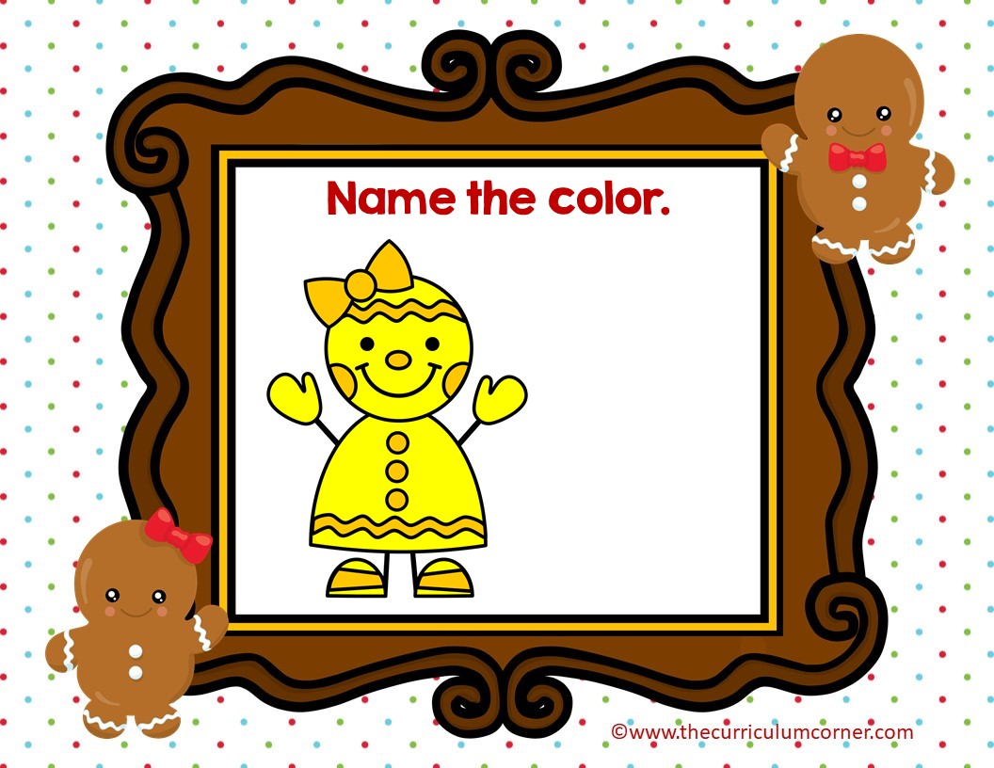
yellow
brown

Slide 3

Oops!
click here to try again
©www.thecurriculumcorner.com
©www.thecurriculumcorner.com

Slide 4

WOW!
click here to go to the next
©www.thecurriculumcorner.com
©www.thecurriculumcorner.com

Slide 5
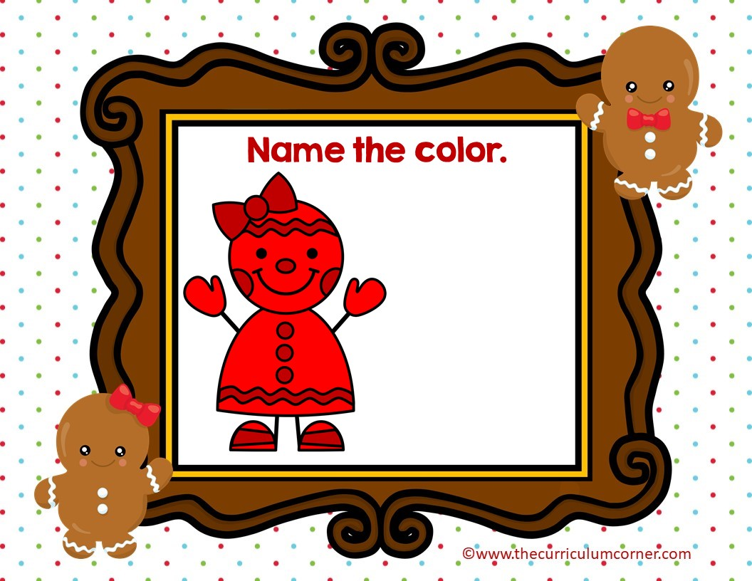
green
red

Slide 6
Oops!
click here to try again
©www.thecurriculumcorner.com
©www.thecurriculumcorner.com

Slide 7
WOW!
click here to go to the next
©www.thecurriculumcorner.com
©www.thecurriculumcorner.com

Slide 8
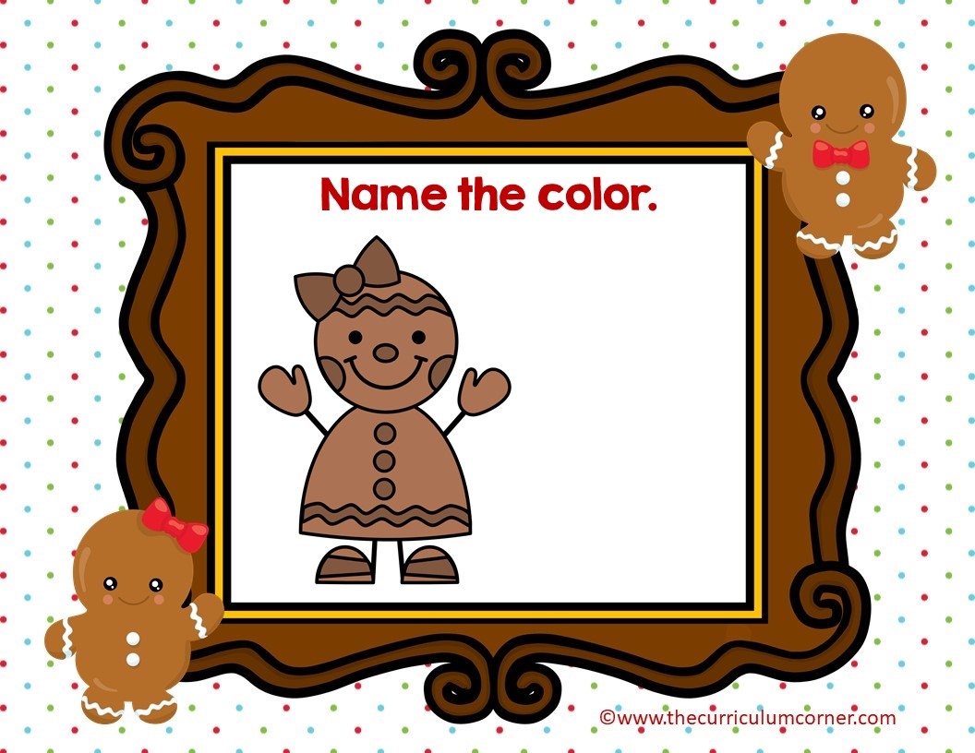
brown
red

Slide 9
Oops!
click here to try again
©www.thecurriculumcorner.com
©www.thecurriculumcorner.com

Slide 10
WOW!
click here to go to the next
©www.thecurriculumcorner.com
©www.thecurriculumcorner.com

Slide 11
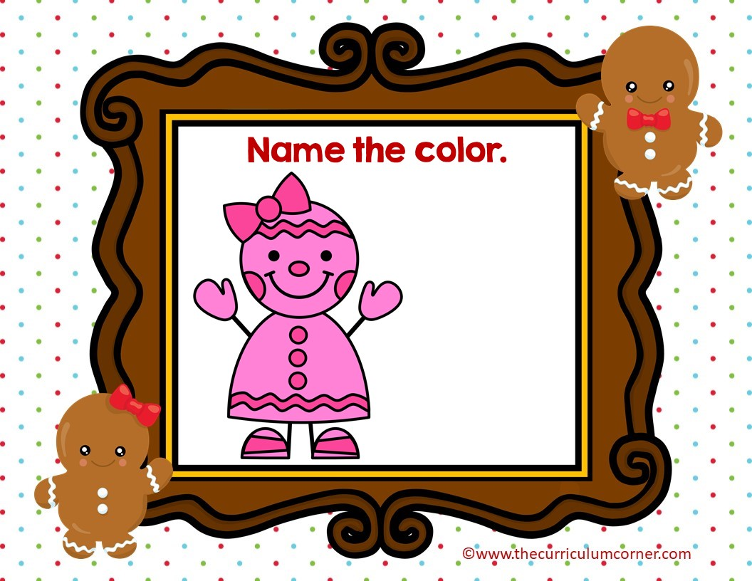
orange
pink

Slide 12
Oops!
click here to try again
©www.thecurriculumcorner.com
©www.thecurriculumcorner.com

Slide 13
WOW!
click here to go to the next
©www.thecurriculumcorner.com
©www.thecurriculumcorner.com

Slide 14
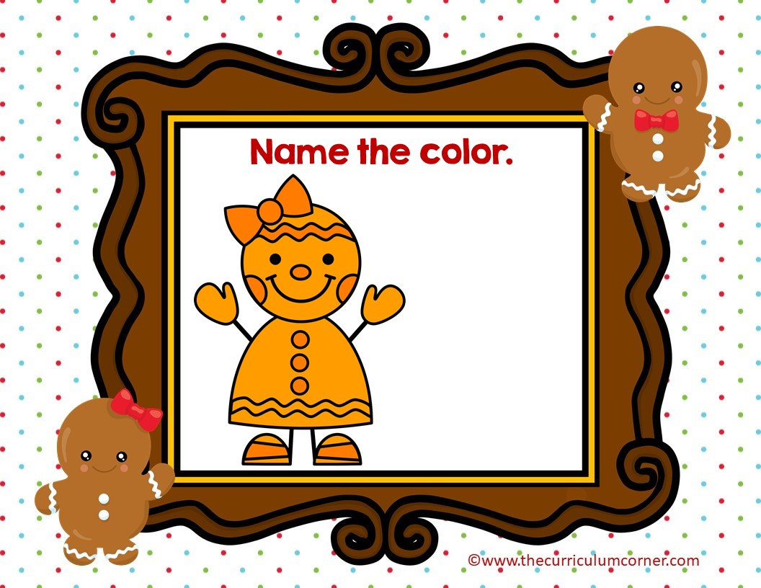
green
orange

Slide 15
Oops!
click here to try again
©www.thecurriculumcorner.com
©www.thecurriculumcorner.com

Slide 16
WOW!
click here to go to the next
©www.thecurriculumcorner.com
©www.thecurriculumcorner.com

Slide 17
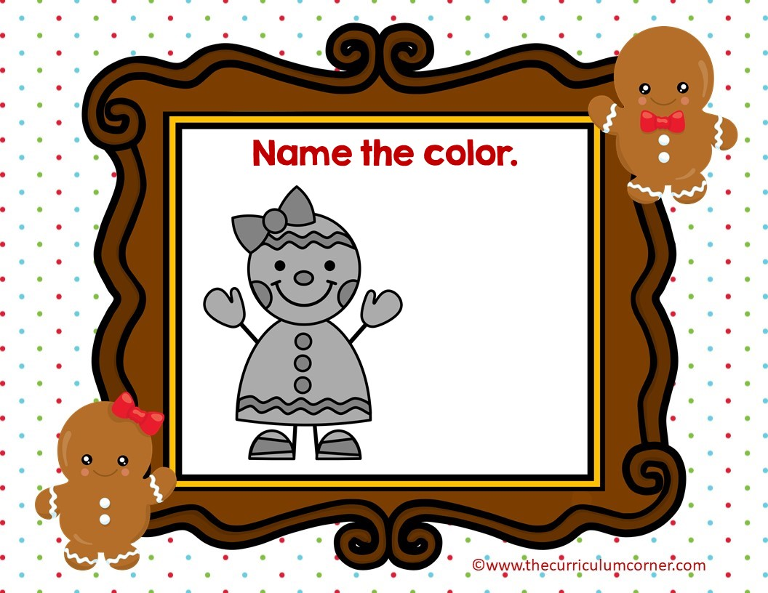
yellow
gray

Slide 18
Oops!
click here to try again
©www.thecurriculumcorner.com
©www.thecurriculumcorner.com

Slide 19
WOW!
click here to go to the next
©www.thecurriculumcorner.com
©www.thecurriculumcorner.com

Slide 20
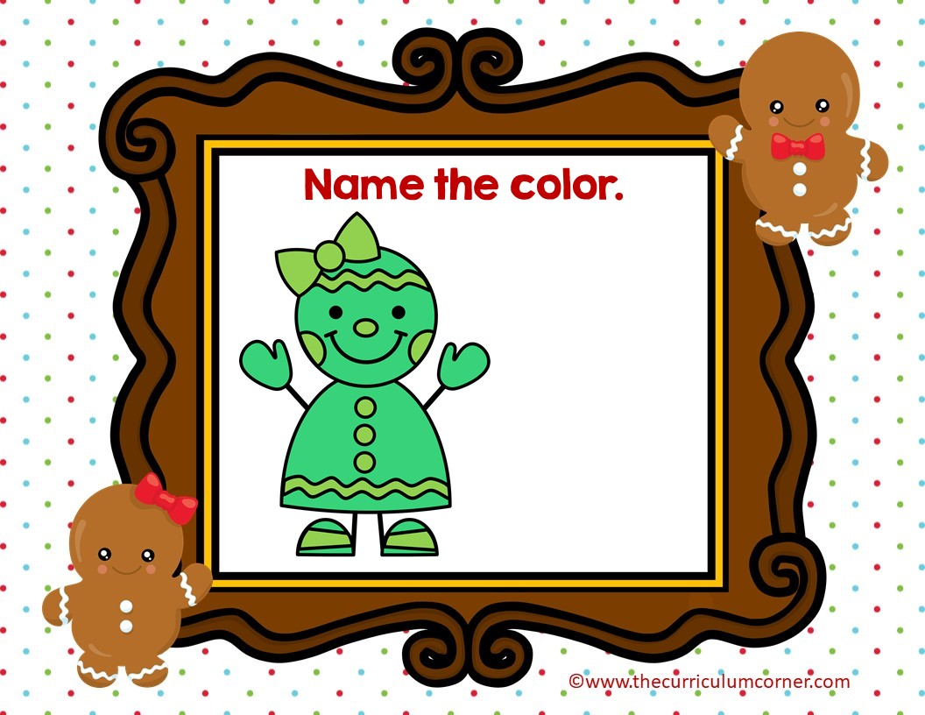
green
blue

Slide 21
Oops!
click here to try again
©www.thecurriculumcorner.com
©www.thecurriculumcorner.com

Slide 22
WOW!
click here to go to the next
©www.thecurriculumcorner.com
©www.thecurriculumcorner.com

Slide 23
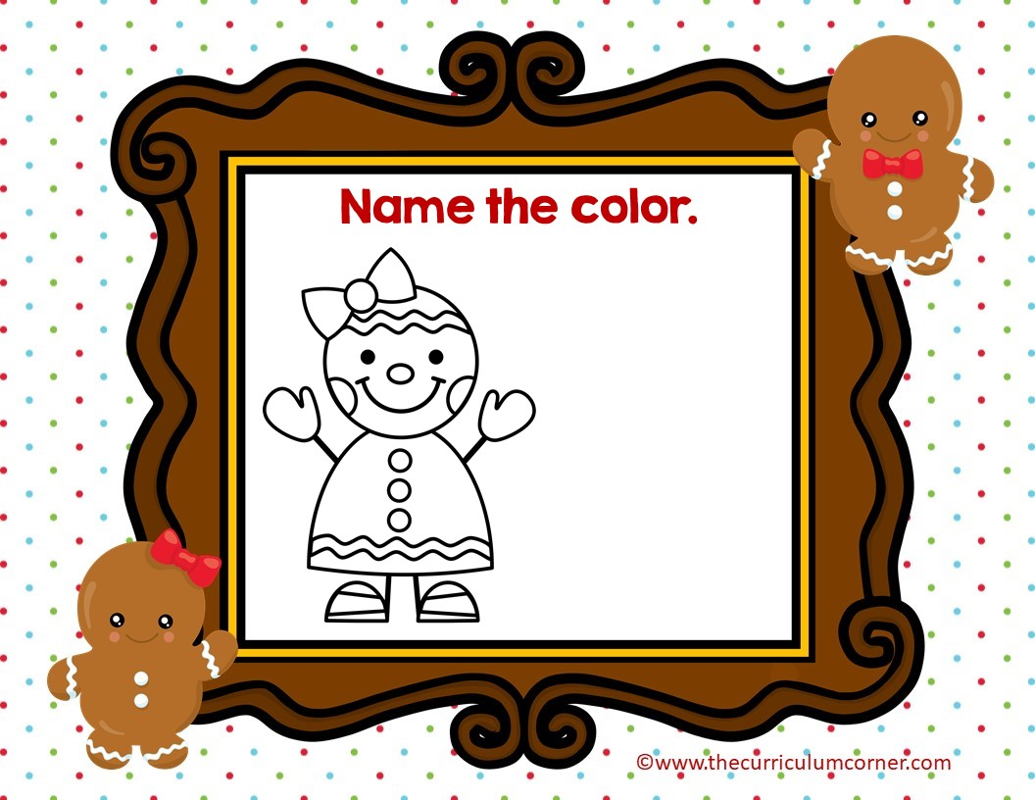
orange
white

Slide 24
Oops!
click here to try again
©www.thecurriculumcorner.com
©www.thecurriculumcorner.com

Slide 25
WOW!
click here to go to the next
©www.thecurriculumcorner.com
©www.thecurriculumcorner.com

Slide 26
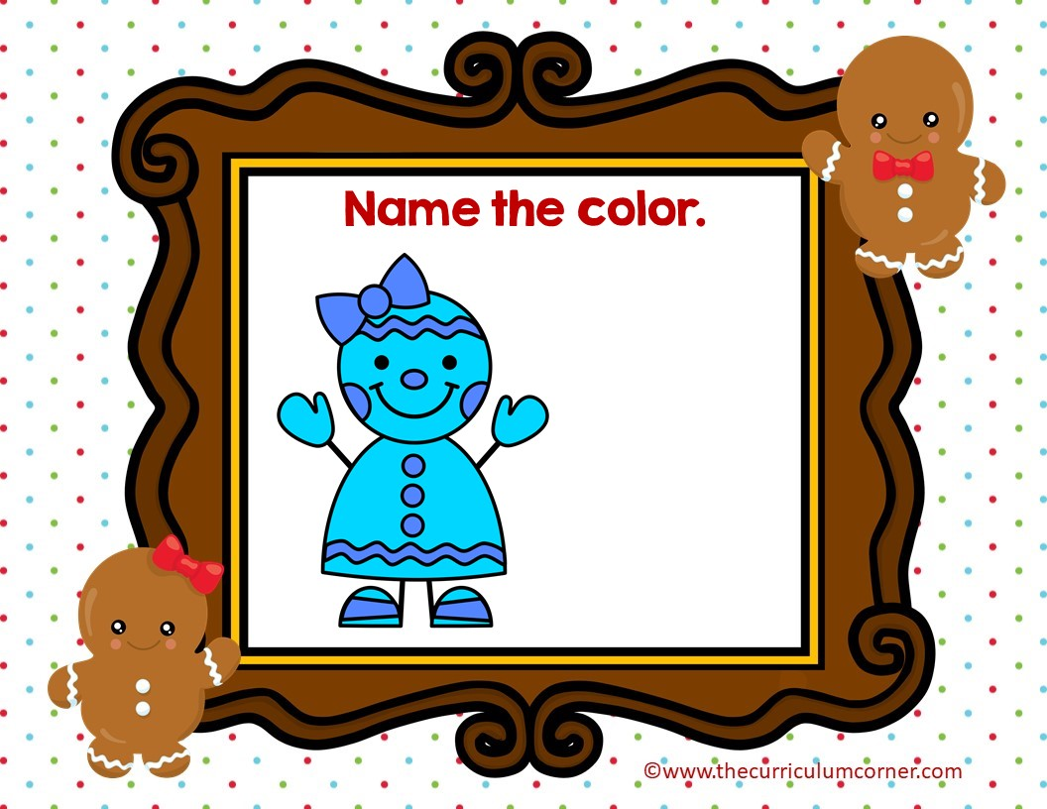
blue
purple

Slide 27
Oops!
click here to try again
©www.thecurriculumcorner.com
©www.thecurriculumcorner.com

Slide 28
WOW!
click here to go to the next
©www.thecurriculumcorner.com
©www.thecurriculumcorner.com

Slide 29
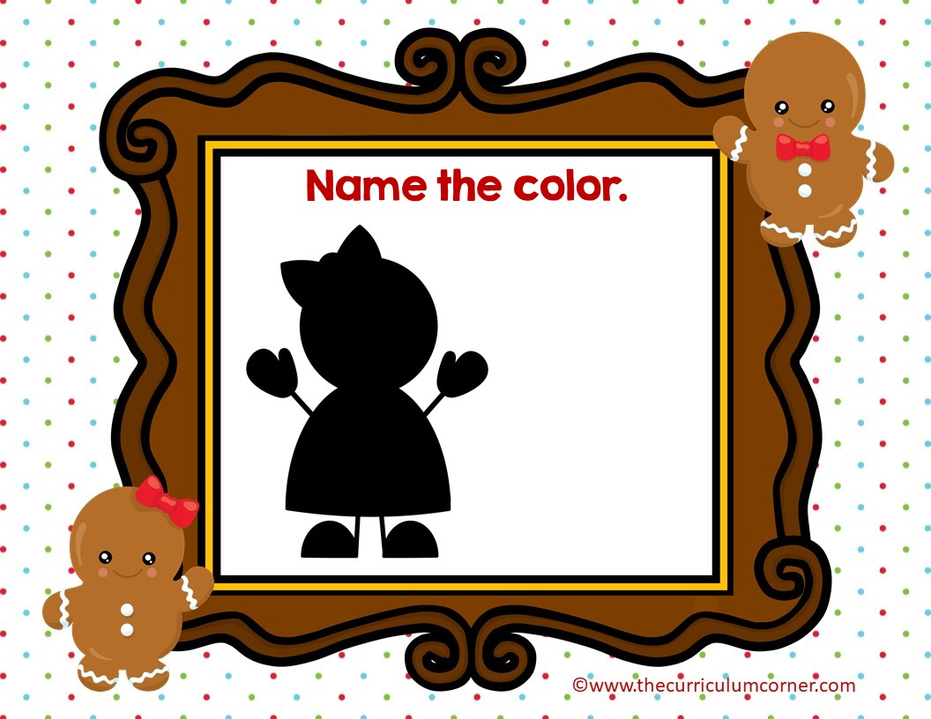
red
black

Slide 30
Oops!
click here to try again
©www.thecurriculumcorner.com
©www.thecurriculumcorner.com

Slide 31
WOW!
click here to go to the next
©www.thecurriculumcorner.com
©www.thecurriculumcorner.com

Slide 32
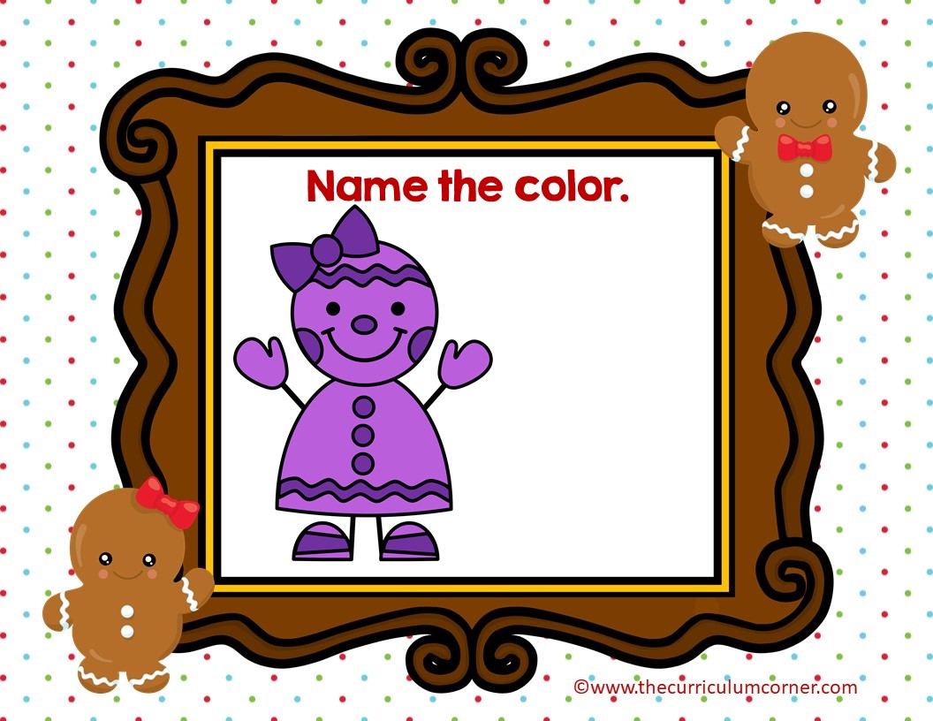
purple
red

Slide 33
Oops!
click here to try again
©www.thecurriculumcorner.com
©www.thecurriculumcorner.com

Slide 34
WOW!
click here to go to the start
©www.thecurriculumcorner.com
©www.thecurriculumcorner.com

